Slide 1

Restaurant Cost Savings and Staffing Efficiency Analysis
Francis Ojinnaka
Kurant BI Specialist

Slide 2
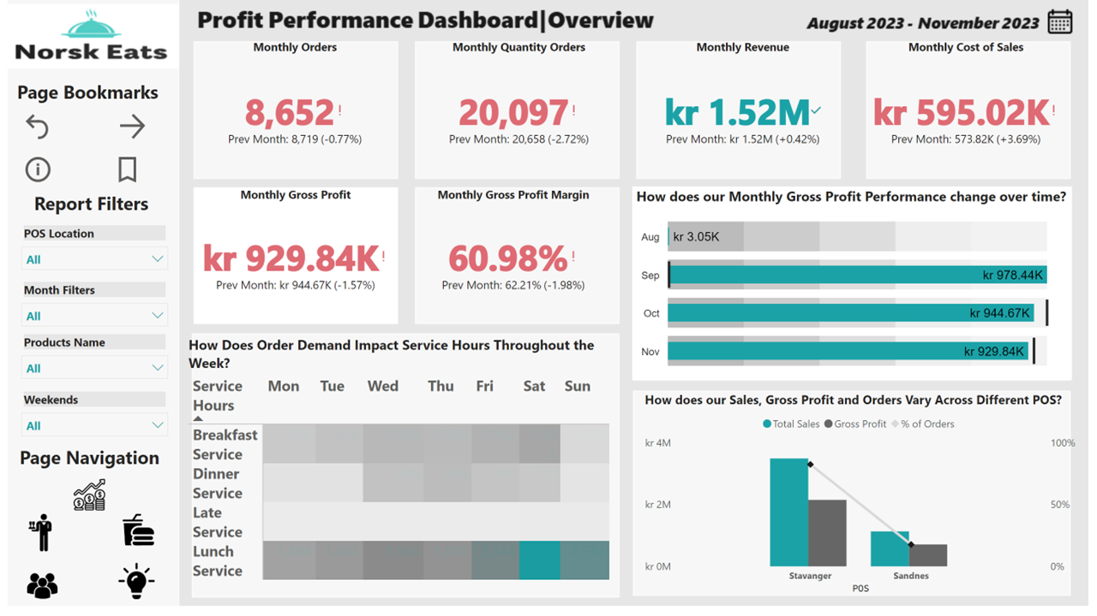
Project Brief
The Norsk Eats dashboard provides a detailed view of cost operations, employee productivity, as well as KPIs such as MoM%.
It visualizes the total daily sales including key metrics like employee shift hours versus last month.
By analyzing these trends, It can gain a deep understanding of its cost efficiency and employee productivity and identify areas for improvement.
A picture of the dashboard

Slide 3
Table of Contents
Business Problem and Data Source
Data Methods
Tech Stack/Resources
Dashboard End users and layout
What I learned from the case
Integrating Interactive PowerBI into the presentation
Insights from the case
Recommendations 1 and 2
Limitations of the case
Future Implications
Appendix
Conclusion

Slide 4
Business Problem and Data Source
Case Problem:
I recently started in Kurant and our client, a local manager of a local restaurant called Norsk Eats is asking me for recommendations on how to improve staffing and profitability.
Data Source:
I received the data from my manager in an excel file containing a sample transactional sales table (fact table), and a time sheet table (fact table), with two more independent tables (dimension tables) that tell me more about the products and employees.

Slide 5
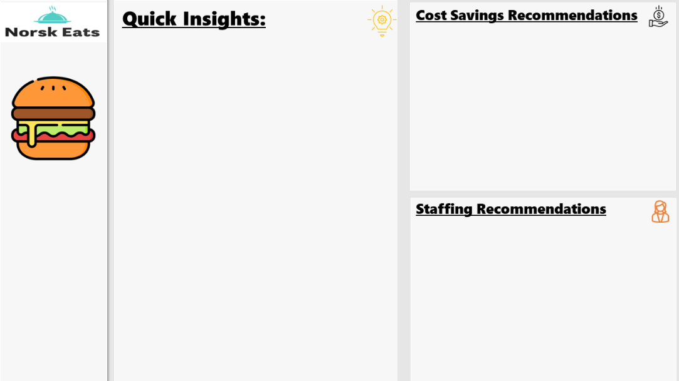
Tech Stack/Resources
I will be dividing my tech stack and resources into two categories namely
Data Analytics and Visualization resources.
Data Reporting and designing resources
Data Analytics and Visualization resources: I used the combination of Microsoft Excel and PowerBI and Service to solve this case, analyze insights using DAX, visualize the data, schedule refresh, and offer recommendations.
Data Reporting and designing resources: I used a lot of reporting and designing resources such as Figma, The Big Books of Dashboards by Steve Wexler, Freepik, Coolors, Looka and Flaticon for dashboard wireframing and color-blind friendly visuals
A dashboard wireframing on Figma

Slide 6
Dashboard End Users and Layout
End Users: The end user of the dashboard is the local branch manager of the restaurant. The manager will be using the insights from the dashboard to make data-driven decisions on how to adjust staffing levels, maximize cost efficiency, and improve their profitability while maintaining quality and service standards.
Dashboard Layout: The dashboard is a combination of both exploratory and explanatory analysis. It identifies interesting patterns and trends that show key business drivers.

Slide 7
What did I learn from the case?
The case was a challenging, exciting, yet interesting one that got me out of my comfort zone.
1
The data has a lot of hidden insights that could improve Norsk Eats 'cost efficiency, profit margin, and staffing issues.
2
It brought out my analytical, problem solving, and dashboard designing skills.
3

Slide 8
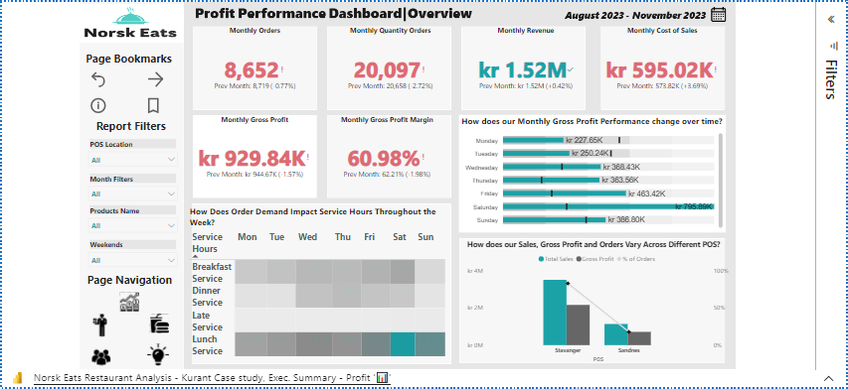
Integrating Interactive PowerBI into the presentation

Slide 9
Quick Insights from the case
Among the two POS locations, Stavanger had the most customers, with orders amounting to 82.4% and a total customer count of 21,901, meaning that 103 out of 125 orders came from Stavanger.
There was a 3.69% increase in the COGS compared to last month of October. This means that the restaurant has spent more money on the ingredients and supply needed to produce the menu items.
On 2.10.2023, there was a sharp decline in daily sales by -93.8%, and the next day. Sales went back to their previous increasing peak on 4.10.2023. Still, on that day, it was observed that 7 employees worked, which means more cost for the business. There is a need to investigate what went wrong on that day, as we had a total order of 15, which is kind of an anomaly.
There was a 3.69% increase in employee turnover compared to the last month of October, which suggests there is a growing challenge by the restaurant in retaining staff. The reasons for this turnover could be low employee satisfaction, poor working conditions, or inadequate compensation.
There was a 6.79% decrease in sales per employee hours which indicates that there was a drop in how the restaurant is using its human capital to generate revenue, maybe due to over-worked workers and understaffing.
On 11.11.2023, we had the highest daily sales of NOK 114,000 with 1452 ordered quantities, with a total of 17 employees working on that day. We need to investigate what led to this event and learn from it in the future.
There are elements of overstaffing and a lot of employees on shift hours during the slowest periods of late services. The late service category had total sales of NOK 10,220 and an average of 12 employees on shift.

Slide 10
Recommendations 1
How can we improve cost savings efficiency?
Menu and Sales optimization
Negotiate better terms with its suppliers.
Usage of pricing techniques to encourage upselling and cross-selling of profitable and complement items.
Utilization of low-cost marketing channels to promote its restaurant.
Implementation of waste reduction strategies.
Implementing loyalty programs to incentivize valuable customers

Slide 11
Recommendations 2
How can we improve staffing efficiency?
Hiring individuals who are passionate about the industry, even if they lack experience.
Developing efficient employee schedules that align with anticipated customer demand.
Implementing strategies to improve employee retention.
Acknowledging and rewarding highly efficient and productive employees.
Putting the right employees in the right places, at the right time.
Cross-train employees to help in various restaurant tasks

Slide 12
Limitations of the Case
No selling price column included.
No column on Labour cost included such as wages and salaries.

Slide 13

Future Implications
The insights provided by the dashboard will have a long-term implication for the restaurant’s growth, sales strategy, employee efficiency, and overall performance.
By analyzing these, Norsk Eats can continue to improve its growth and sales efforts and stay ahead of its competitors.

Slide 14
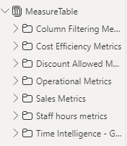
Appendix
The DAX calculations I performed on an independent table I created solely for calculations hence to solve the case. I also put them on a folder for organization purposes.

Slide 15
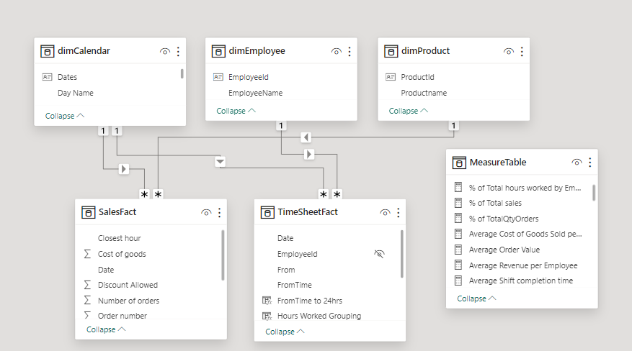
Appendix
The data modeling process of the analysis for robust analysis – a star schema modelling with two fact tables and three independent dimension tables connected via primary and foreign keys.

Slide 16
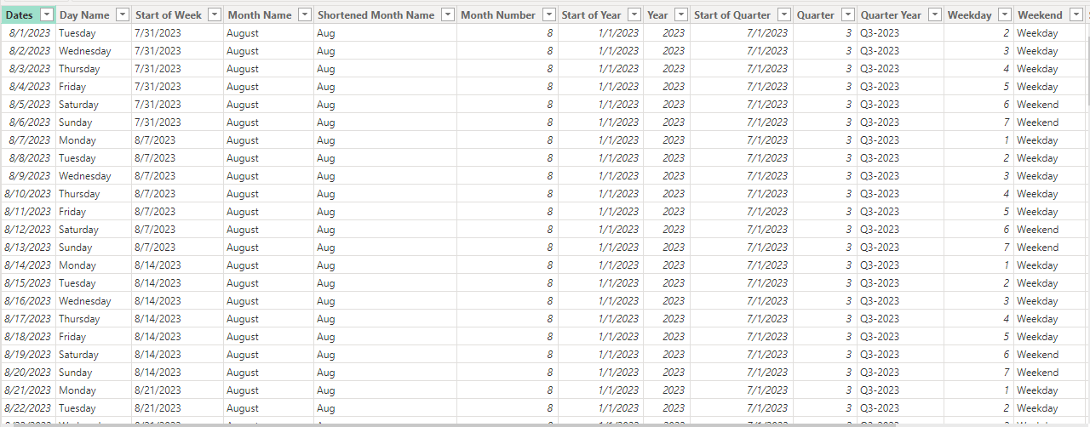
Appendix
The Calendar table I created and included to the model hence to perform robust time intelligence functions.

Slide 17
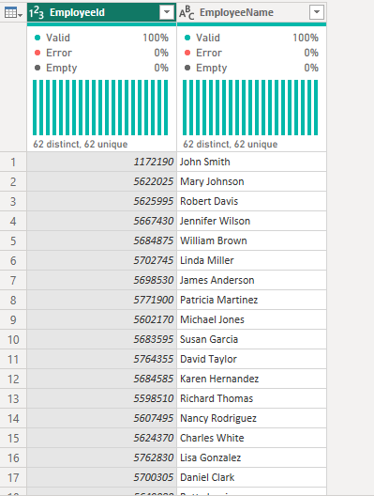
Appendix
I did a column quality level test on all tables hence to check for likely data errors, nulls, and duplicates on the data which is the foundation of any analysis project.

Slide 18
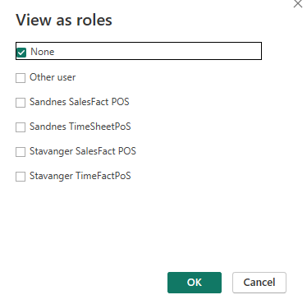
Appendix
I did a row level security on the dashboard so as to limit what users can view and interact with

Slide 19
Conclusion
Thank you for reading.☺
Francis Ojinnaka

